Slide 1
Morphology and ultrastructure of bacteria

Slide 2
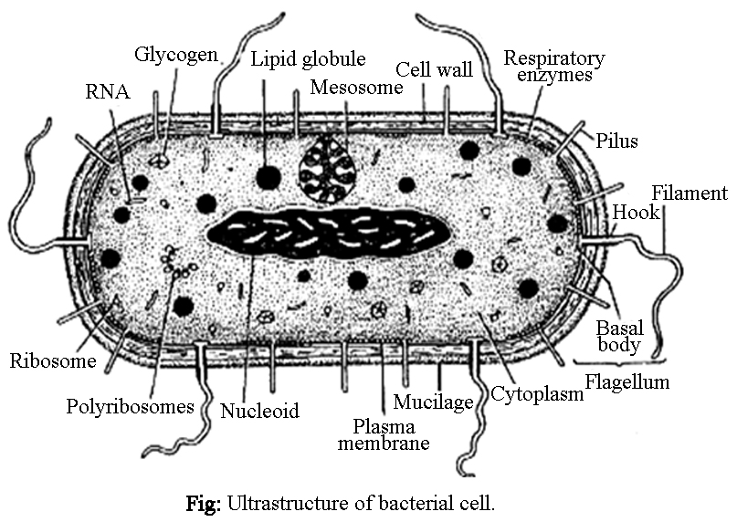

Slide 3
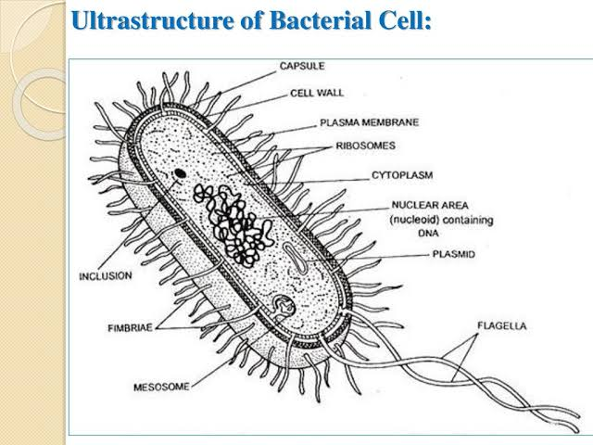

Slide 4
Bacteria are microscopic (small size 0.5 to 2µm), unicellular, prokaryotic organisms.
A variety of shapes
Outer cell wall made of specialized molecule( Peptidoglycan).
Cell membrane may have different constituency of molecule from eukaryote cells
Ribosome smaller.
No nuclear membrane.
Single molecule of ds DNA arranged in the form of a circle.

Slide 5
Morphology of bacteria
following morphology characteristics of bacteria:
Shape:
Size:
Arrangement:
Flagella:
Spores:
Capsule:
Motility

Slide 6
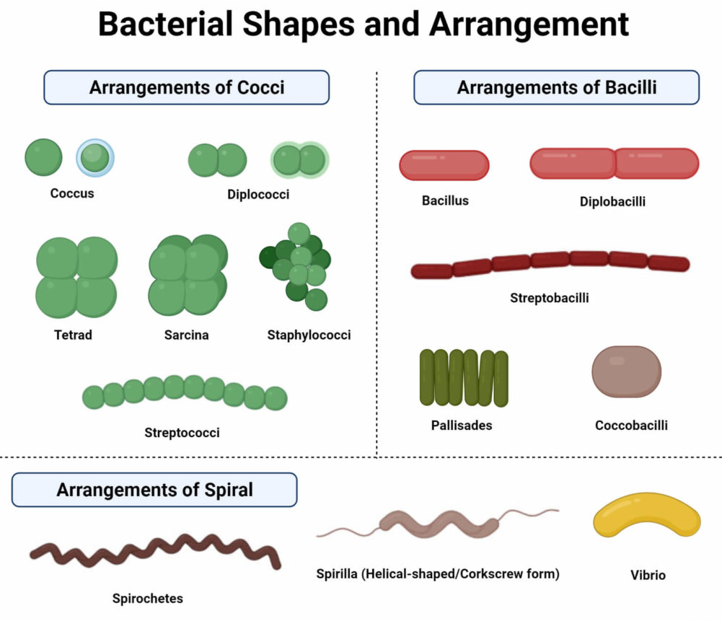

Slide 7
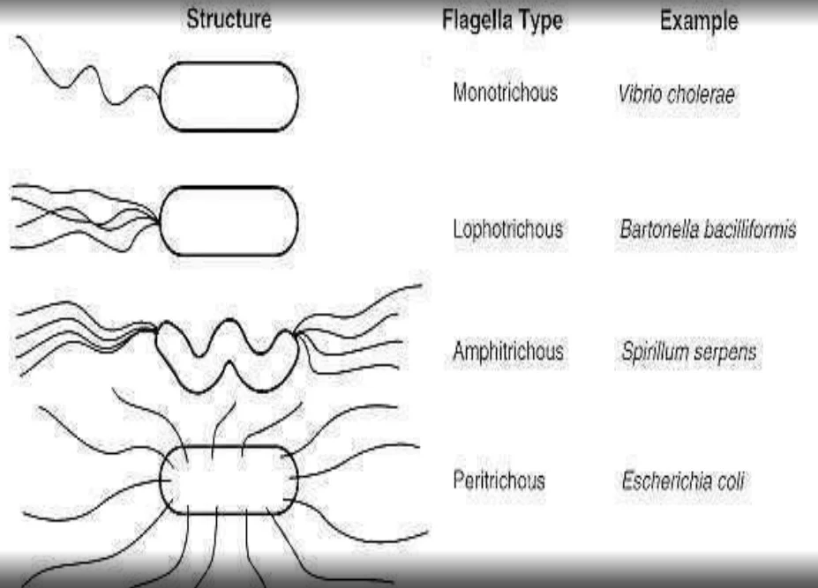
Flagella
Pseudomonas fluorescens
Nitrosomonas

Slide 8
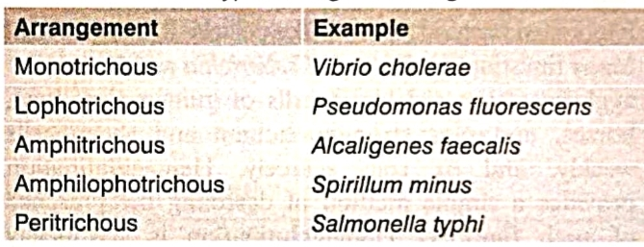
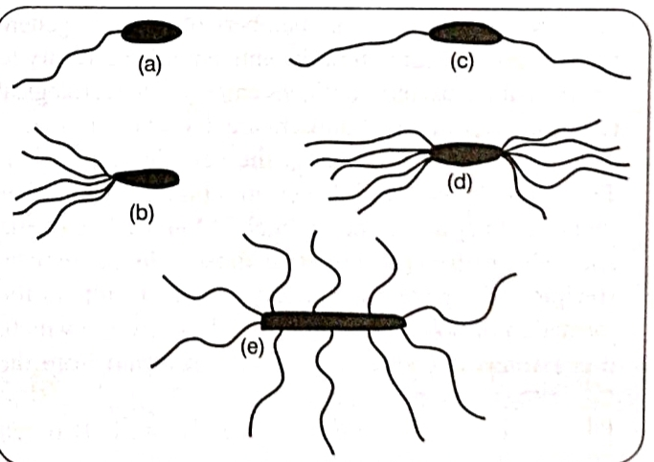

Slide 9
Ultra structure of Bacteria
Cell envelope : consists of
Glycocalyx
Cell wall
Cell membrane
Glycocalyx (Mucilage Sheath)-
Outermost mucilage layer of cell envelope which consists of non-cellulosic polysaccharides with or without protein.

Slide 10
Glcocalyx may occur in the form of loose sheath when it is called slime layer.
If thick and tough, the mucilage covering is called capsule.
Capsule – made up of polysaccharide.
It protect bacterium from drying out and to protect it form phagocytosis by larger microorganism.
Capsule major virulence factor , such as E.coli and streptococcus pneumoniae.

Slide 11
Cell wall:
This structure is responsible for the shape, rigidity.
Protect the cell from osmotic lysis, toxic substance and pathogens.
Site of action of several antibiotics.

Slide 12
Plasma membrane:
It is selectively permeable covering of the cytoplasm that form the innermost component of cell envelope.
It is made up of a phospholipid bilayer with protein of various types.
Cytoplasm:
It is a colloidal system comprising a variety of organic and inorganic solutes in a viscous Watery solution.

Slide 13
It contain ribosome, mesosomes, inclusion bodies.
Ribosome: These act as a the centres of protein synthesis.
70S type ribosome( 30S and 50S).
Mesosomes: It is a characteristics circular in growth from the plasma membrane.
Consist vesicle, tubules and lamellae.
Mesosome is of two types, septal and lateral.

Slide 14
Nucleoid: represnt genetic material .
Consists of Single molecule of ds DNA arranged in the the form of a circle.
Inclusion Bodies:
Inclusion bodies may occur freely inside the cytoplasm
On the basis of their nature, they are of 3 types:
Gas vacuoles
Inorganic inclusions
Food reserve.

Slide 15
Cell wall
It is the layer, usually fairly rigid, that lies just outside the plasma membrane.
Determine the shape of the cell.
Protect the cell from osmotic lysis, toxic substances and pathogens.
composed of Peptidoglycan.
The bacterial cell wall differs from that of all other organisms by the presence of peptidoglycan .
Cell wall of Gram positive bacteria thick as compared to Gram negative.

Slide 16
Peptidoglycan (murein) is made up of a polysaccharide backbone consisting of alternating N -acetylmuramic acid (NAM) and N-acetylglucosamine (NAG) residues in equal amounts.
Alternating sugars are connected by a β-1,4-glycosidic bond.
Tetrapeptide chain: 4 amino acids(L-alanine, D-glutamic acid, meso-diaminopimelic acid, D-alanine) attached tp carboxylic group of NAM.
In case of Gram + bacteria replace DAP with usually L-Lysine.

Slide 17
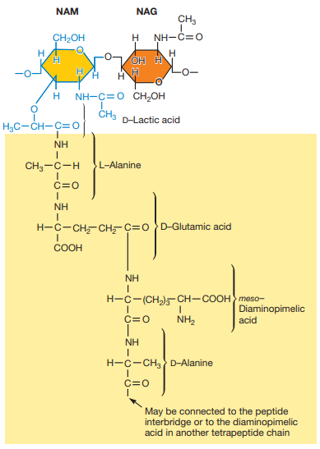

Slide 18
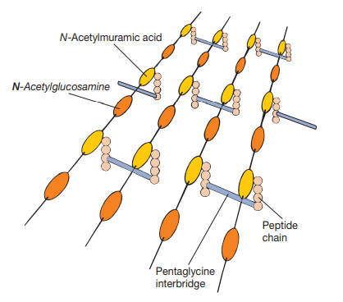

Slide 19
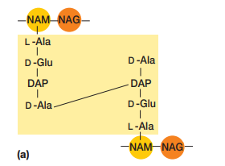
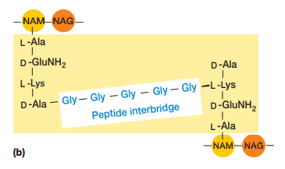

Slide 20
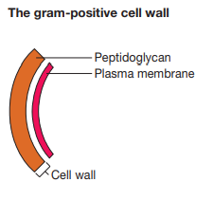
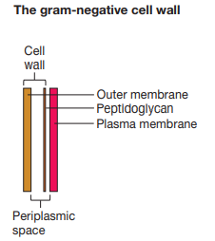
20-80 nm thick layer of peptidoglycan
2-7 nm peptidoglycan layer

Slide 21
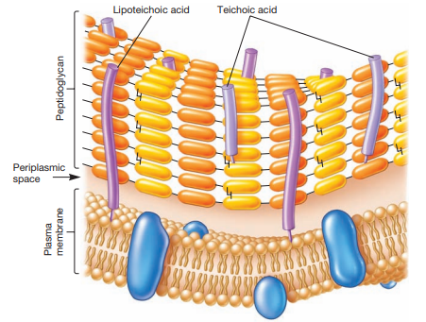
Cell wall of Gram positive bacteria

Slide 22
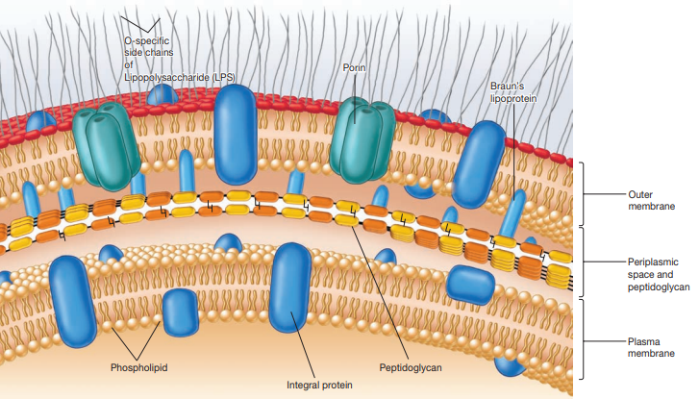
Cell wall of Gram negative bacteria

Slide 23
Cell wall synthesis

Slide 24
Synthesis of Peptidoglycan
peptidoglycan is a large, complex molecule consisting of long polysaccharide chains made of alternating N-acetylmuramic acid (NAM) and N-acetylglucosamine (NAG) residues.
Nucleoside diphosphate sugars also participate in the synthesis of peptidoglycan.
reactions occur in the cytoplasm, others in the membrane, and others in the periplasmic space.

Slide 25

Peptidoglycan synthesis involves two carriers.
1. uridine diphosphate (UDP)
2. second carrier, bactoprenol phosphate
Bactoprenol is a 55- carbon alcohol and is linked to NAM by a pyrophosphate group

Slide 26
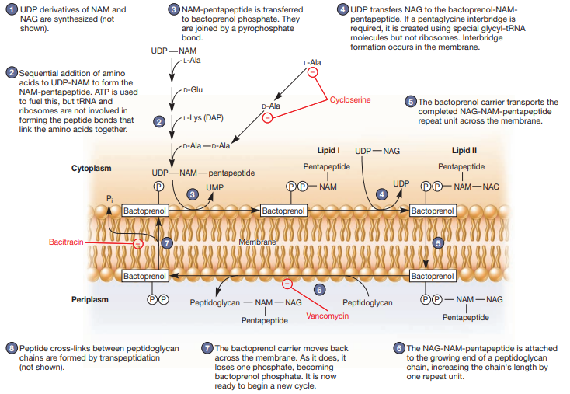

Slide 27
transpeptidation
The final step in peptidoglycan synthesis is transpeptidation , which creates the peptide cross-links between the peptidoglycan chains.
The enzyme that catalyzes the reaction removes the terminal D-alanine as the cross-link is formed.

Slide 28
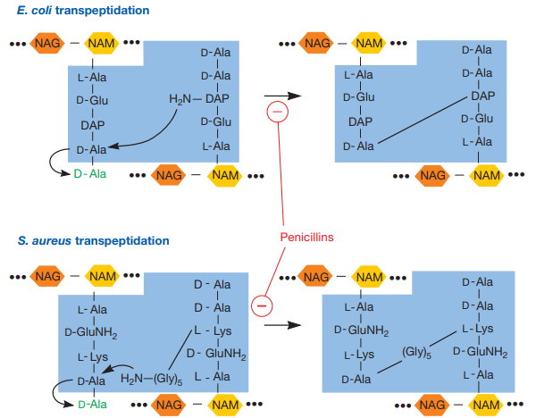

Slide 29
importance of peptidoglycan to bacterial cell wall structure and function, its synthesis is a particularly effective target for antimicrobial agents.
Inhibition of any stage of synthesis weakens the cell wall and can lead to lysis.
Many commonly used antibiotics interfere with peptidoglycan synthesis.
For example, penicillin inhibits the transpeptidation reaction.
bacitracin blocks the dephosphorylation of bactoprenol pyrophosphate .

Slide 30
Pili and Fimbriae
Pili - hair like microfibers that are thick tubular structure made up of pilin.
- longer than fimbriae.
-they are helpful in attaching to recipient cell and forming conjugation tube.
- made up of pilin protein.
- found in gram negative bacteria.

Slide 31
Fimbriae- tiny bristle like fibers arising from the surface of bacteria.
- made up of fimbrillin protein.
- Fimbriae are involved in attaching bacteria to solid surface or host tissues.
- essential for the virulence of some bacterial pathogens.

Slide 32
Flagella-
are long (upto15-20 μm) and thin (about 20nm ) .
They are the organs of locomotion.
Flagella are divided into three parts:
Filament
Hook
Basal Body

Slide 33
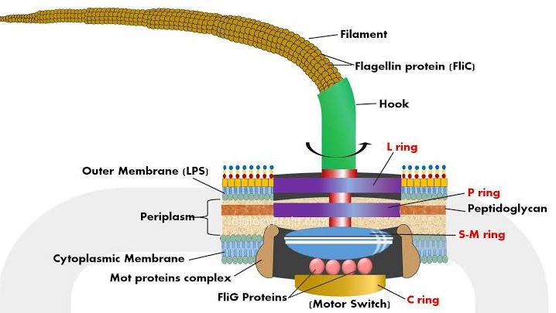
Flagellum of gram negative bacteria

Slide 34
Filament-
thin, cylindrical, long thread like part extending outside the cell wall.
made up of flagellin protein.
Hook-
short curved structure that joins filament with the basal body.
Slightly wider than filament.

Slide 35
Basal Body-
set of rings embedded in the cell wall and plasma membrane.
Gram negative bacteria- consists of
L-ring embedded in lipo-polysaccharide layer of outer membrane.
P-ring (peptidoglycan)
S-ring(supermembrane) in above cytoplasmic membrane.
M(membrane)-ring with in cytoplasmic membrane.
C (cytoplasmic) ring is located in the cytoplasm.
Gram-positive bacteria lack the lipopolysaccharide layer, only S, M and C rings ring are present.

Slide 36
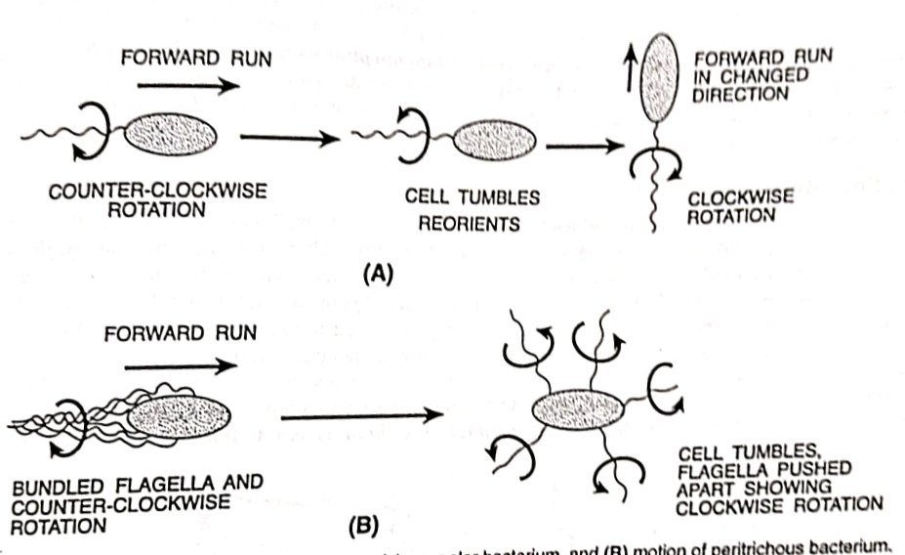
Flagellar movement

Slide 37
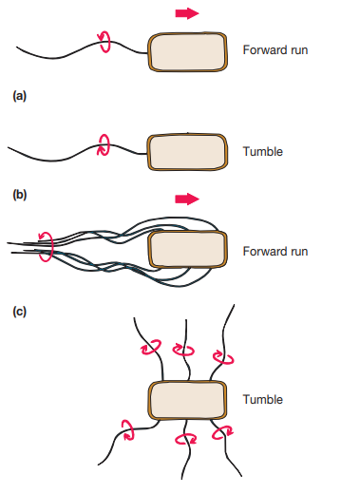

Slide 38
Cytoplasm
It is a colourless, colloidal, viscous fluid with suspended organic and inorganic solutes enclosed within the plasma membrane.
they lack membrane-bound organelles.
They have ribosomes, mesosomes, inclusion bodies, nucleic acids floating in them.

Slide 39
Gas Vacuoles
organic inclusion bodies, are formed as a result of the aggregation of enormous number of small, hollow, cylindrical structures called gas vesicles.
a structure that provides buoyancy to some aquatic prokaryotes.
Gas vacuoles are present in many photosynthetic bacteria and a few other aquatic prokaryotes such as Halobacterium (a salt- loving archaeon) and Thiothrix (a filamentous bacterium).

Slide 40
Each gas vesicle is a spindle –shaped, single –membrane bound gas-filled structure made of protein.
The protein subunits assemble to form the wall and is impermeable to water but freely permeable to atmospheric gases.
Two different proteins, GvpA and GvpC.

Slide 41
Chromosome
Bacterial chromosome is simple and is represented mainly by double stranded DNA molecule.
Covalently closed circular structure consisiting of only a single molecule of DNA .

Slide 42
Carboxysomes
Carboxysomes are present in many cyanobacteria and other CO 2 -fixing bacteria.
They are polyhedral, about 100 nm in diameter, and contain the enzyme ribulose-1,5- bisphosphate carboxylase (Rubisco).
Rubisco is the critical enzyme for CO2 fixation, the process of converting CO2 into sugar.
Carboxysomes also may be a site of CO 2 fixation

Slide 43
Magnetosome
Magnetosome are the inorganic inclusion bodies.
Magnetosomes are intracellular chains of magnetite (Fe3O4 ) particles.
Magnetosome containing bacteria are called magnetotactic bacteria.
Eg: Aquaspirillum magnetotactic.

Slide 44
The main function of magnetosome is probably to guide such bacteria toward the sediment where O2 concentration is lower.

Slide 45
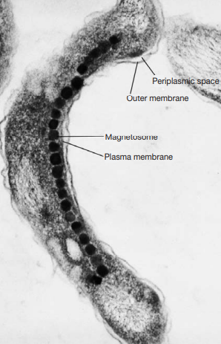

Slide 46
Phycobilisomes
Photosynthetic pigments and electron transport chain components are located in thylakoid membranes lined with particles called phycobilisomes.
Phycobilisomes are aggregates of light harvesting protein attached to stroma side of the thylokoid membranes of the cyanobacteria and red algae.

Slide 47
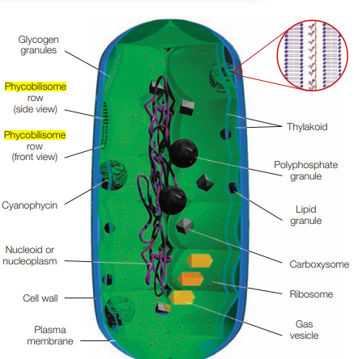
These contain phycobilin pigments, particularly phycocyanin and phycoerythrin, which transfer energy to photosystem II.

